Slide 1

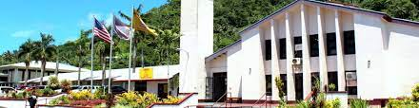
American Samoa 4-H Youth Development Program

Slide 2
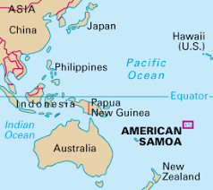
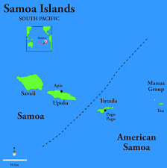

Slide 3
Extension Director: Aufa’i Apulu Rpeti Areta Extension Coordinator: Molly A. Lagai
4-H Manager: Molly A. Lagai
4-H Agents: Toepo Stowers & Elenoa Taisali
2020 US Census: 15,300 youth between ages 5 and 19 (about 30% of the total population).
2021: reached about 1,900 youth through different Extension programs
Activities
Food Safety
Farm Safety
Nutrition
Arts & Crafts (Cultural)
Vegetable Gardening
Tree Planting
Camping
Sewing
Games
4-H Programs
School Outreach
Community Outreach
In-School 4-H Club
Community 4-H Clubs
Campus Tours
4-H Volunteers

Slide 4
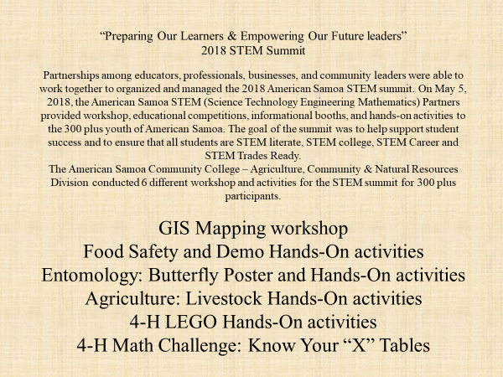

Slide 5
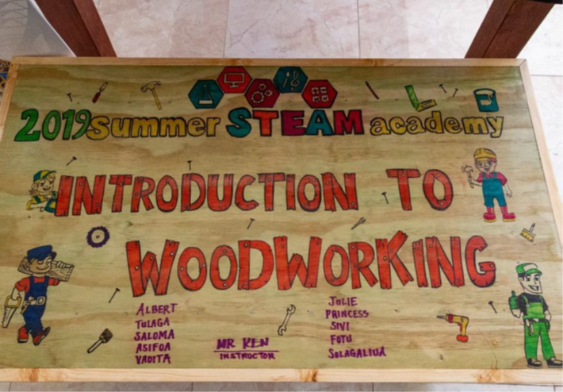
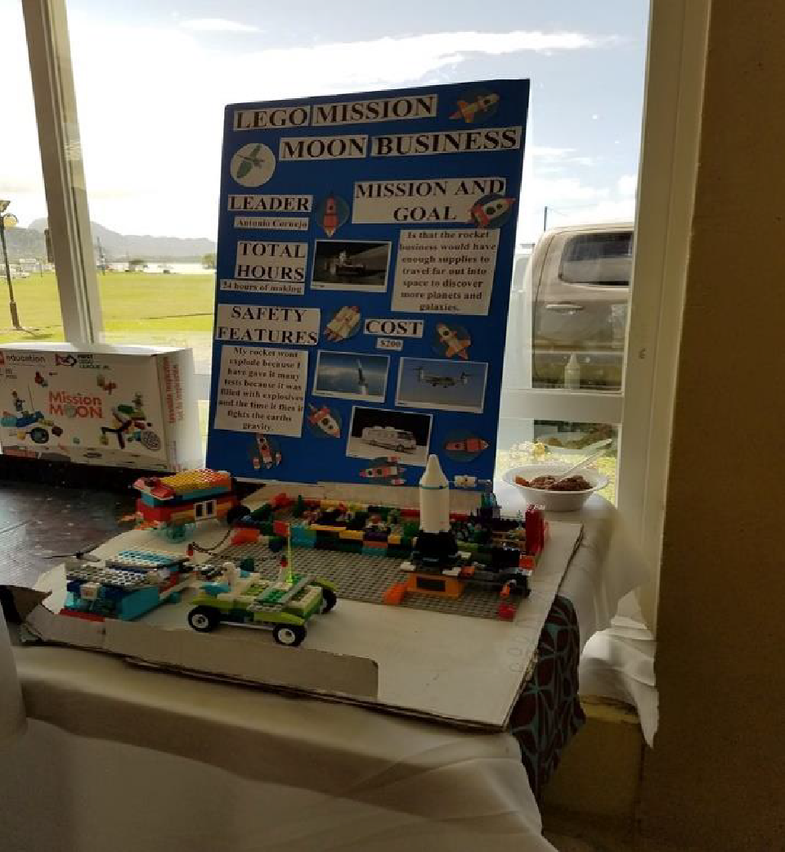
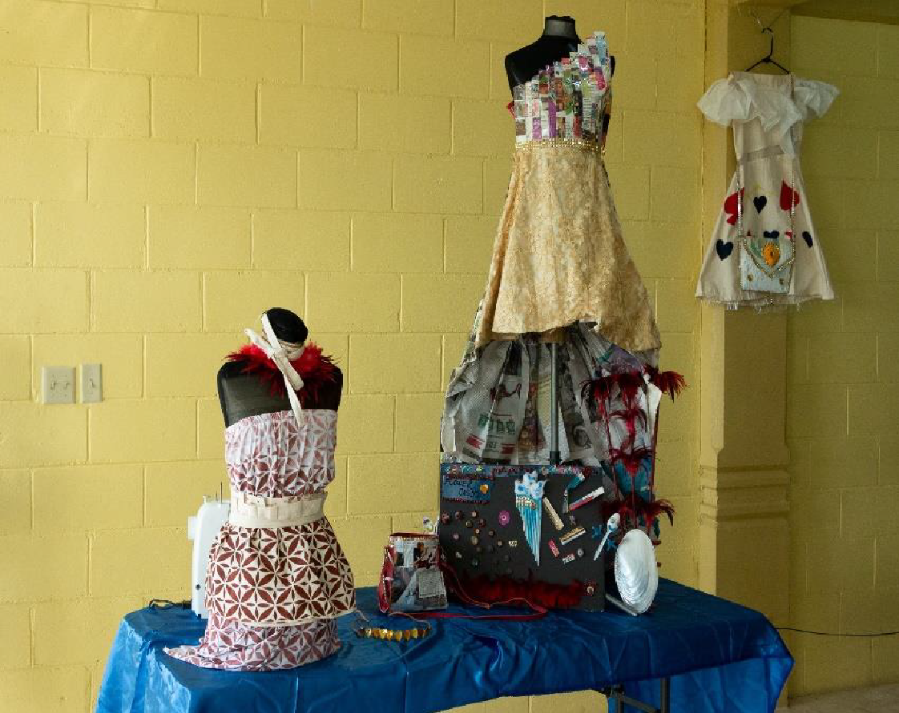
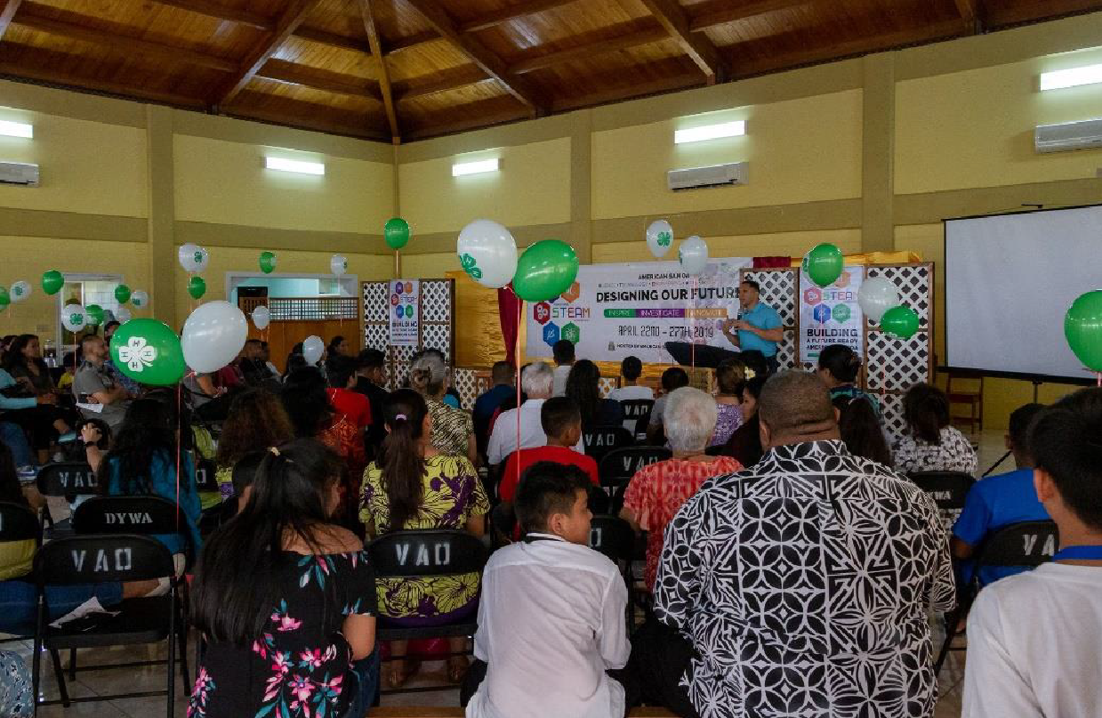
2019 American Samoa STEAM Academy
As a leading partner in the 2019 STEAM summer academy, the 4-H program assisted and supported student curriculums and activities. Eighty students attended classes in Drafting, Science, Woodworking, Cooking, and Fashion & Design for 4 full weeks. The summer academy ended with a Summer Expo that displayed all the projects by the students including a fashion show.

Slide 6
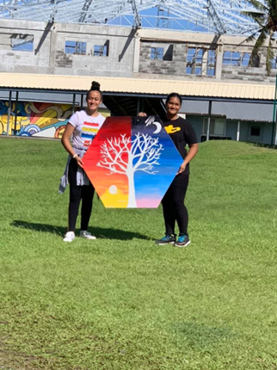
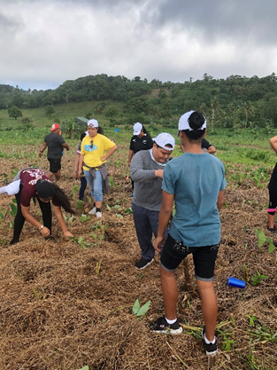

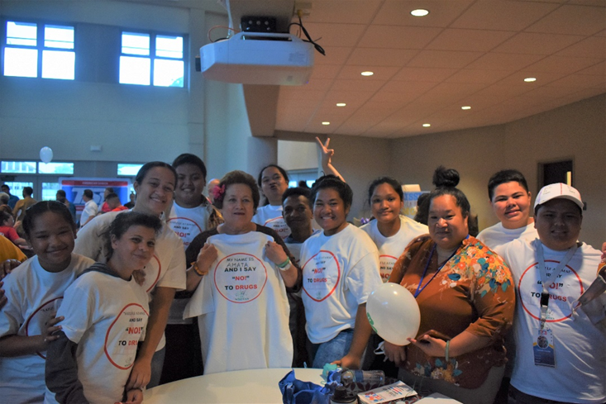

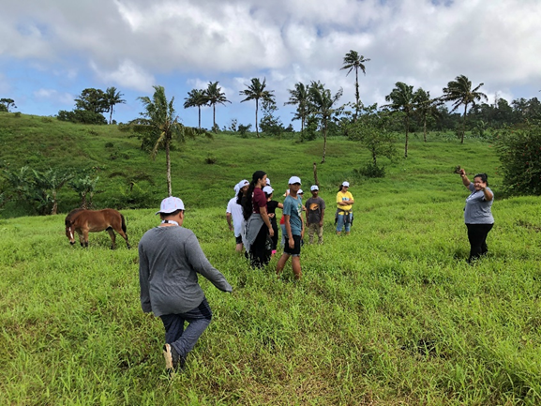
2020 American Samoa STEAM Academy
Hiking

Slide 7
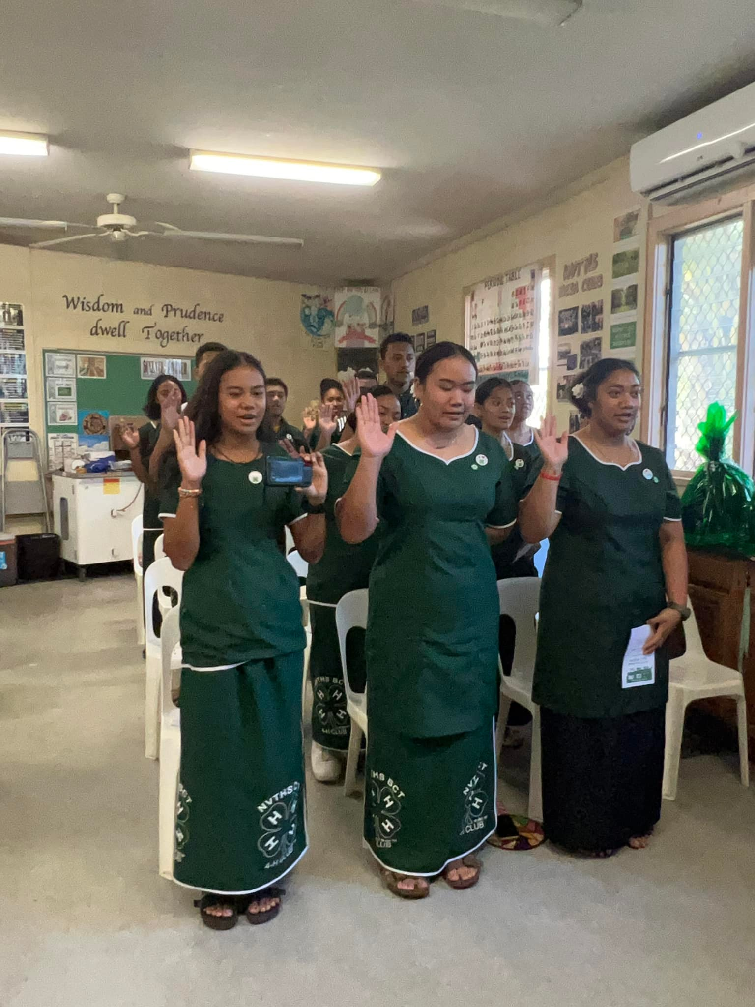
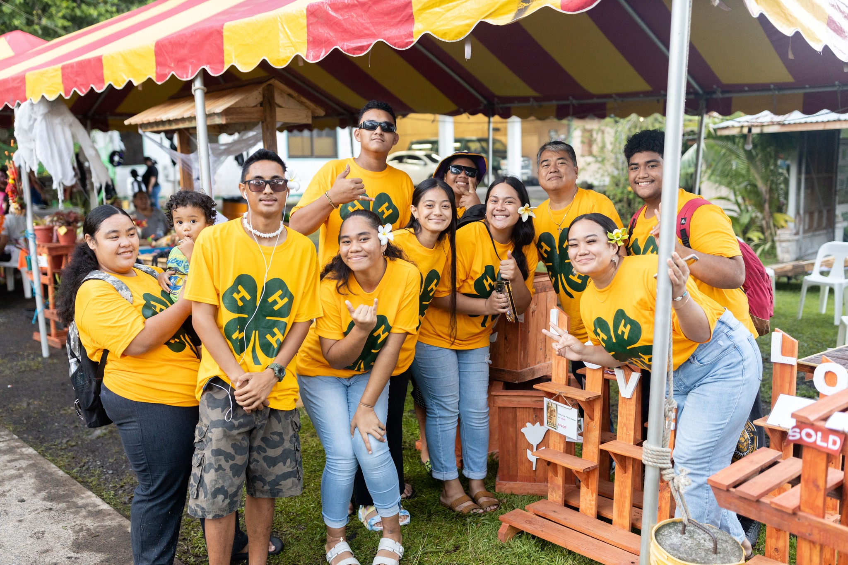
BCT In-School 4-H Club (High School/STEAM): First and only In-school club. Chartered recently and article to be released soon. Goal: “Grow and Thrive”

Slide 8
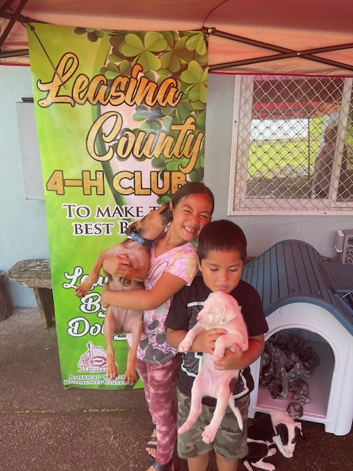
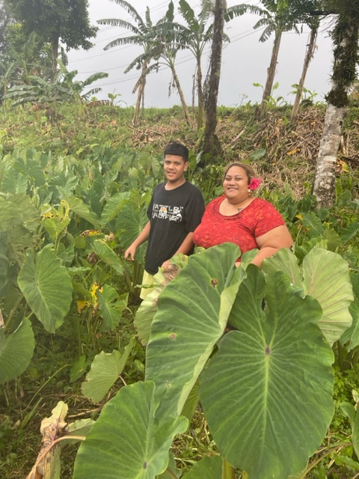
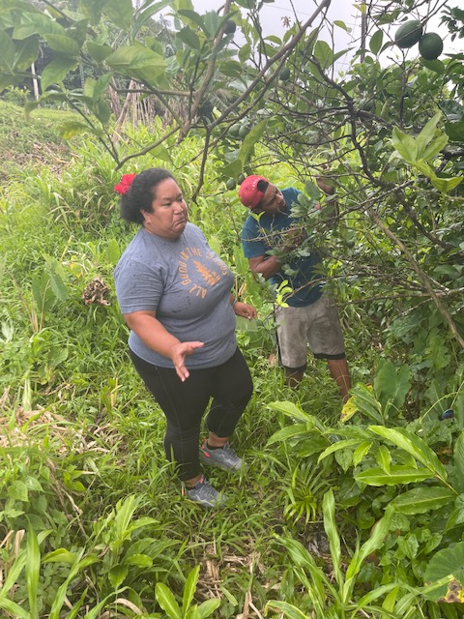
Leasina County 4-H Club (Rural/Farming)
-County known for taro farming
-Decreased engagement/Inconsistent: youth are more occupied with other priorities. Within village settings, faith-based youth programs are the priority.

Slide 9
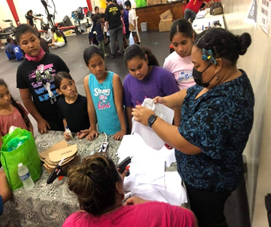
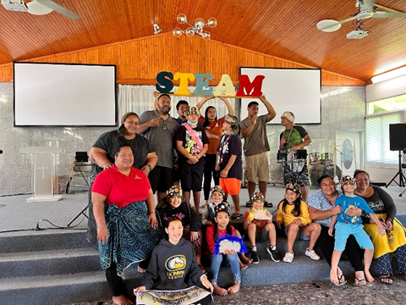
OCEANIA 4-H Club
-Urban Area
-Diversity
Opportunity for other youth with different ethnic backgrounds to join.

Slide 10
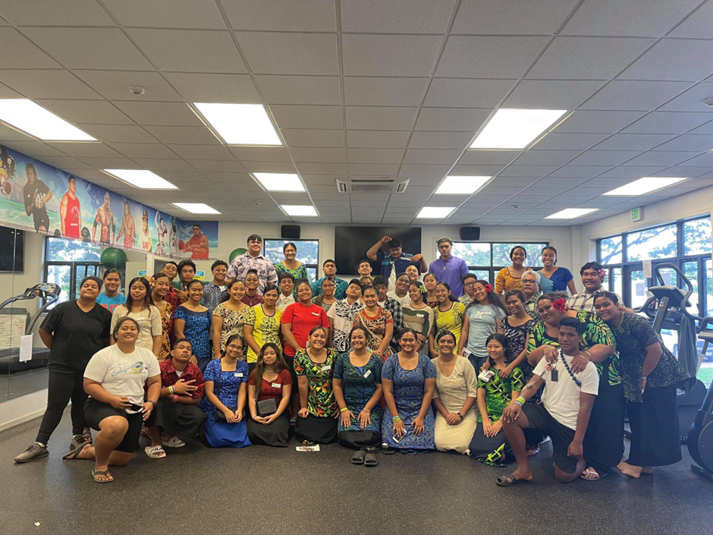
Summer Youth Employment Program The program consisted of 51 youth between the ages of 14 and 21. For two months, these youth have worked and learned about the different Land Grant programs. Different activities include Elei, farm to table activity, exercise, nutrition, forestry health, gardening, sewing, tie dye, textile design, air layer, animal farm, food safety, teamwork and many more.

Slide 11
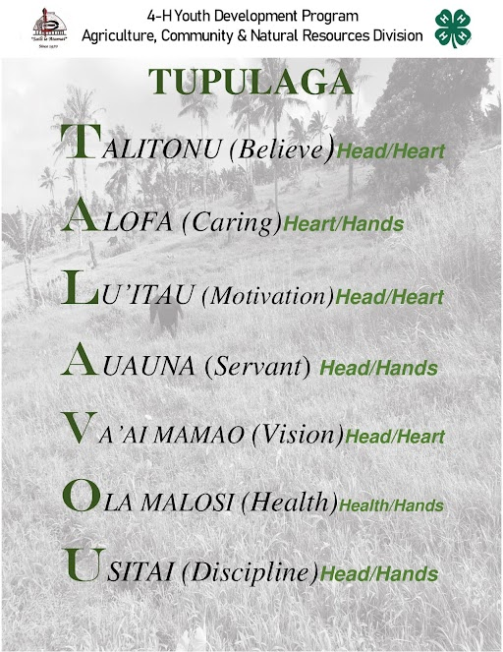
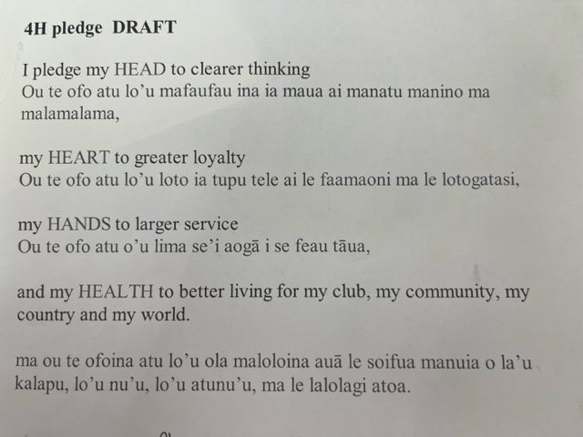
Translation: Bilingual “younger generation”

Slide 12
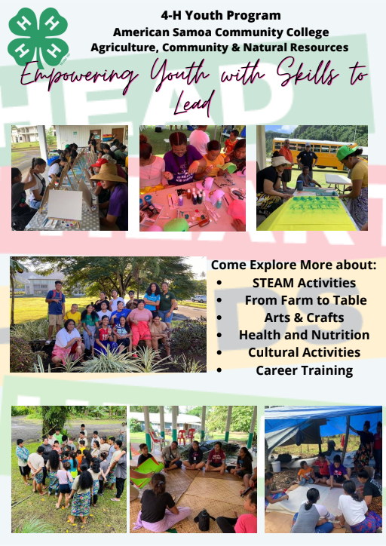
Make do with what we have Backyard is your lab Takes a village to raise a child: Strong partnership with the community

Slide 13
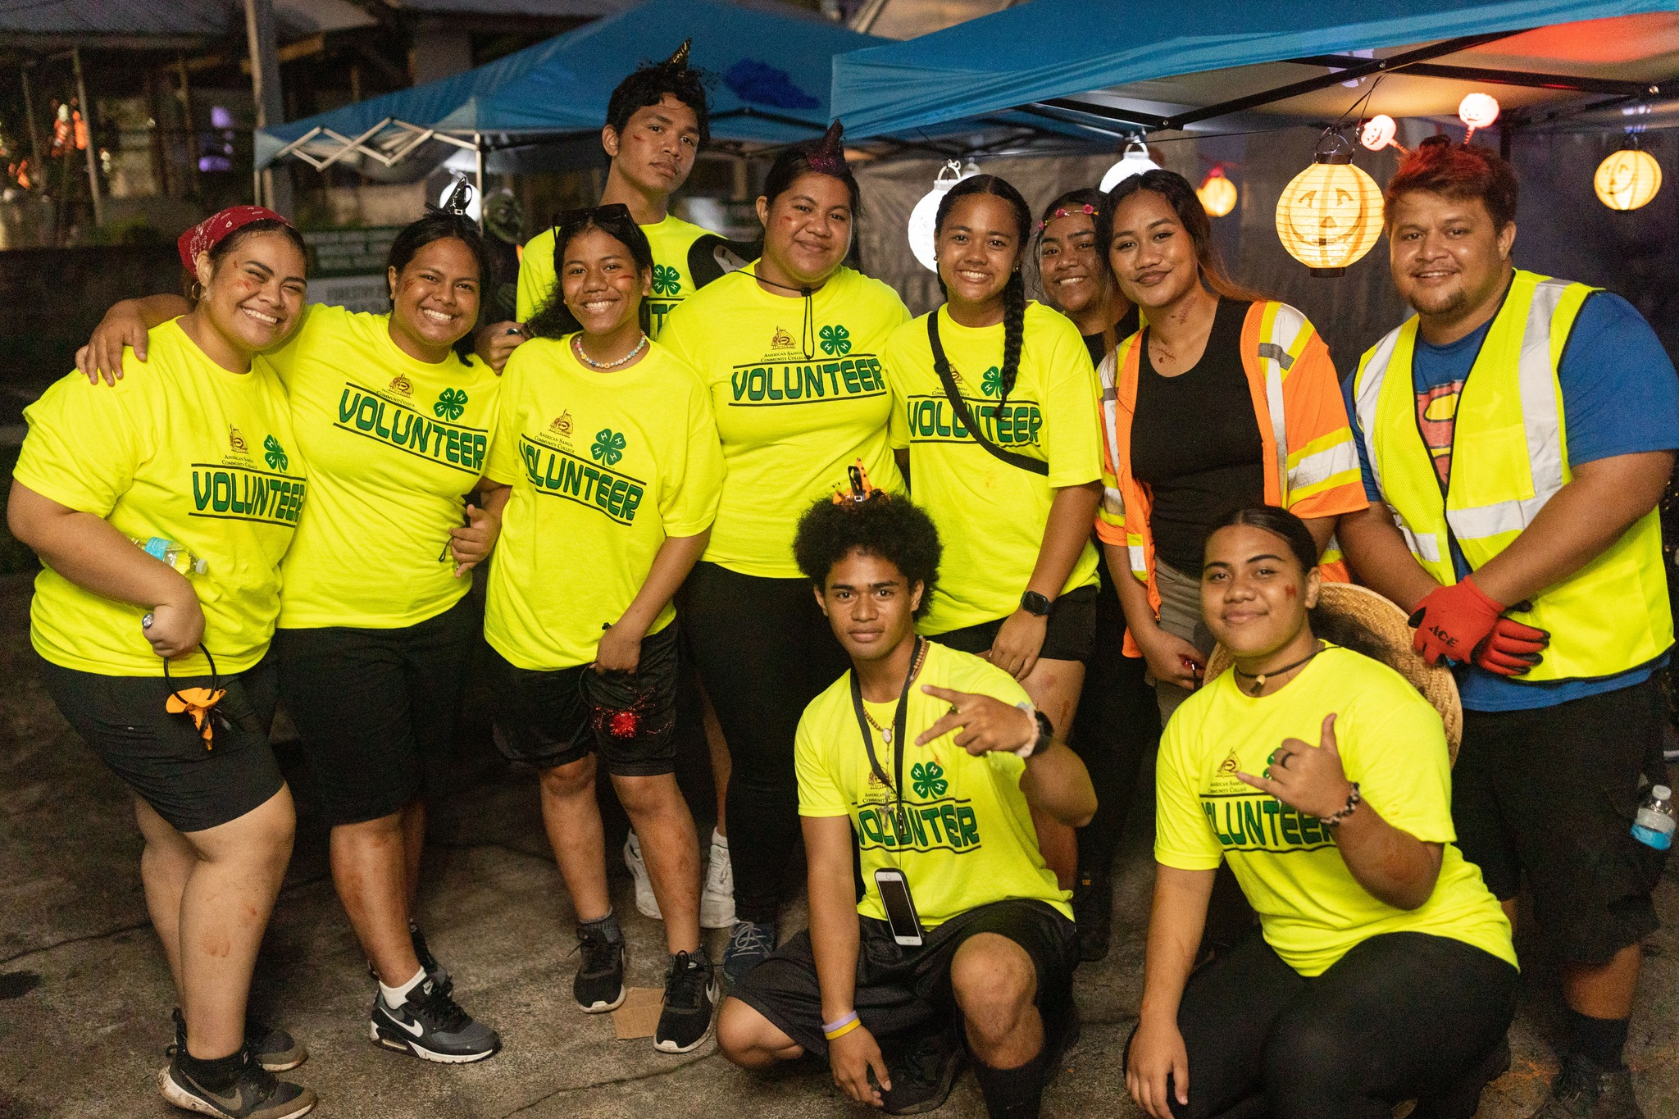
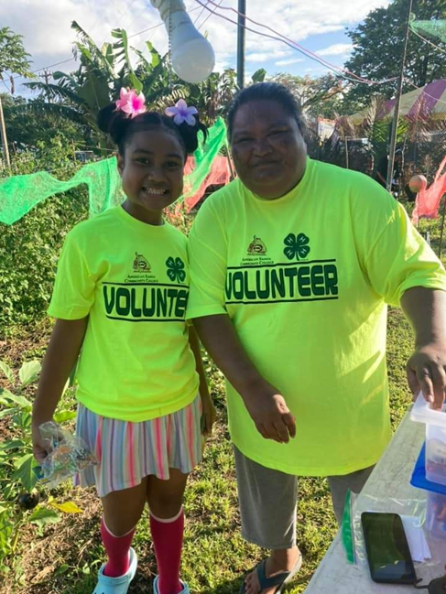
Volunteers: 50 trained participants
American Samoa community always willing to assist

Slide 14
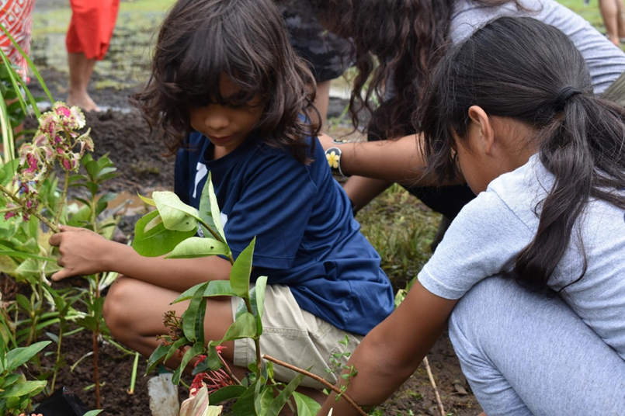
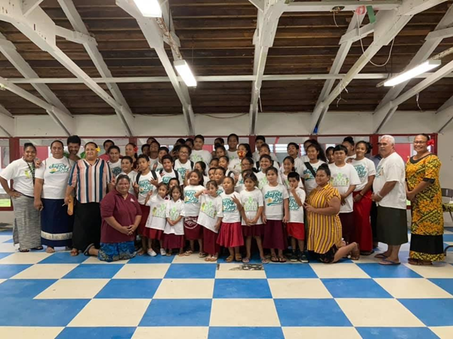
PARTNERSHIPS
*URBAN COMMUNITY FORESTRY (PROTECTING THE ECOSYSTEM/TREE PLANTING)
PROGRESSIVE FARM SAFETY

Slide 15
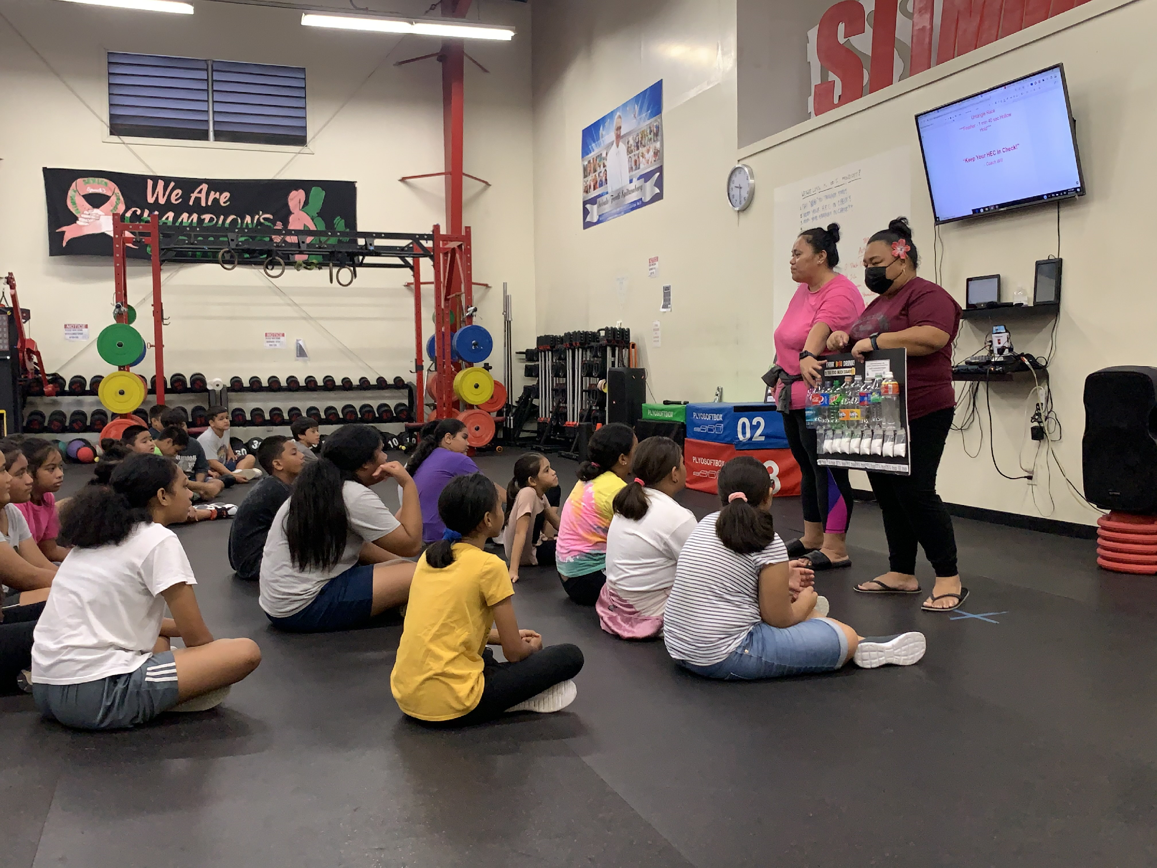
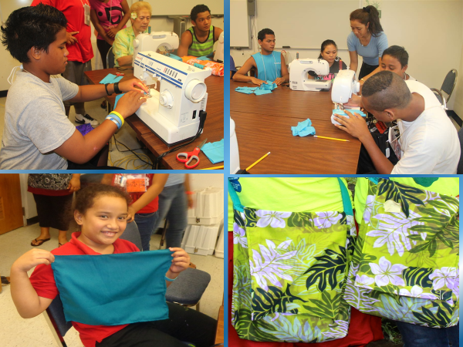
Outside Partners
-DOE
-EPA
-American Samoa STEAM committee
-Parent of Children with Special Needs (PCSN)
Expanded Food & Nutrition Education Program (EFNEP): Sugar Shocker Board activity
FCS Sewing Program: Basic Sewing Program

Slide 16
Challenges
Traditional vs. New Initiatives targeting specific audience.
Parental Involvement (lack of time, knowledge and understanding).
Rural Image
Lack of Research
Transportation to neighboring islands
Localizing materials
Bandwidth (Now available but costly)

Slide 17
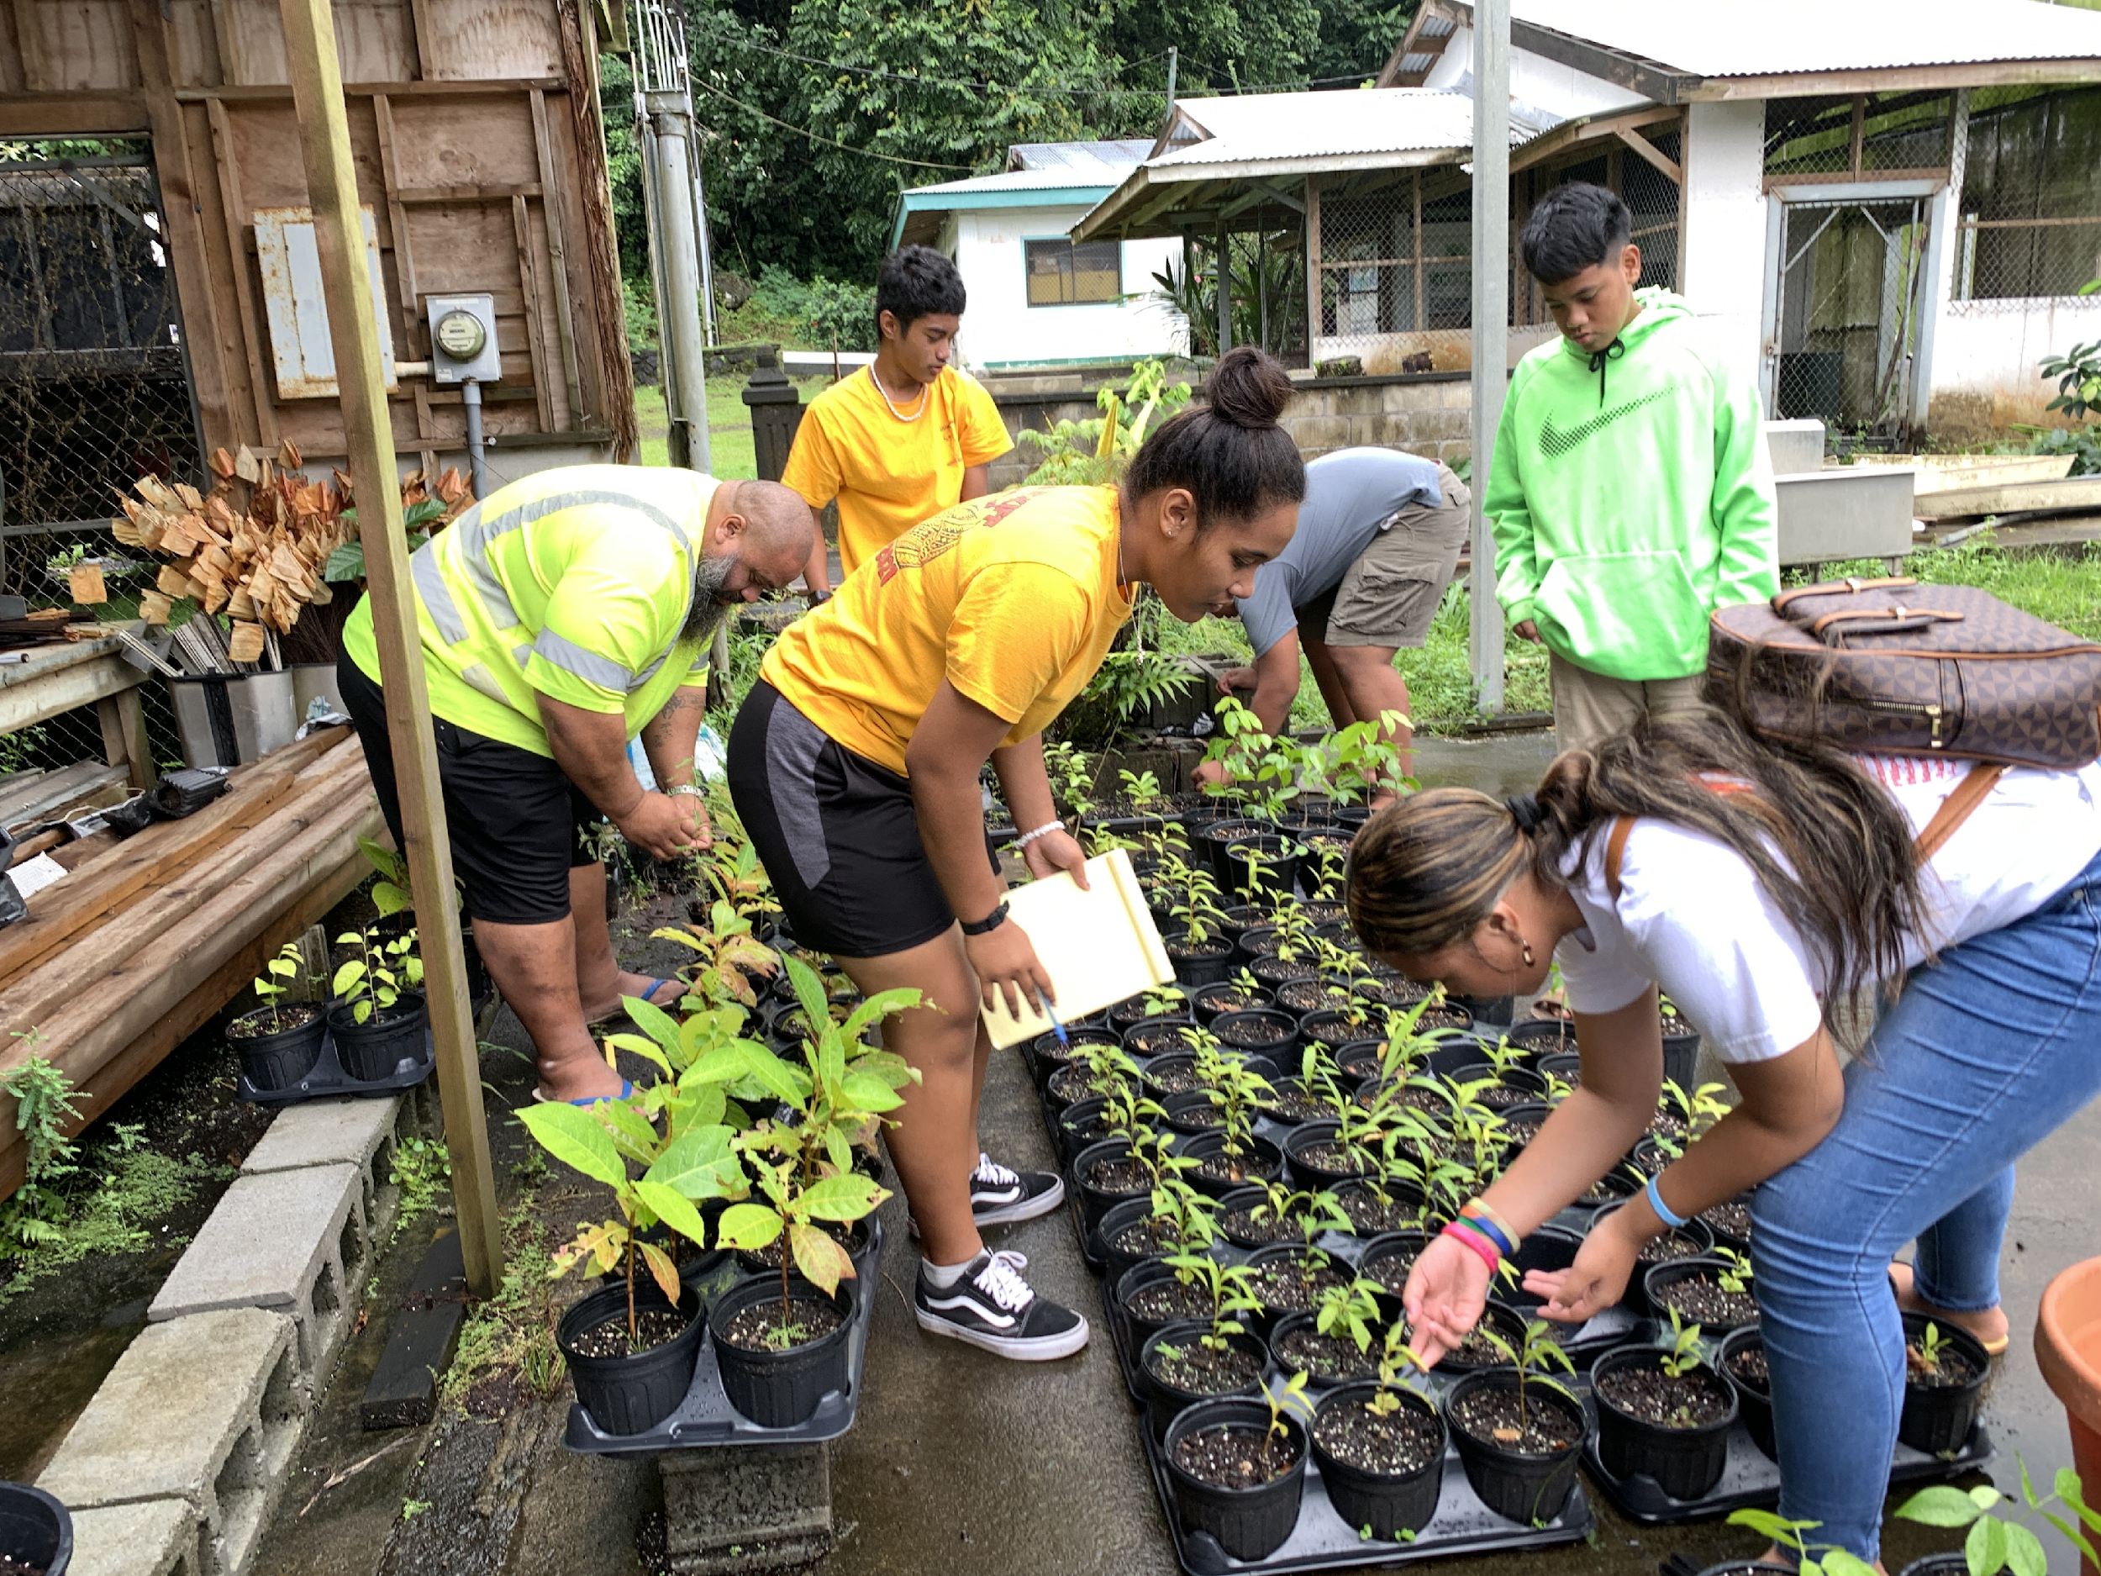
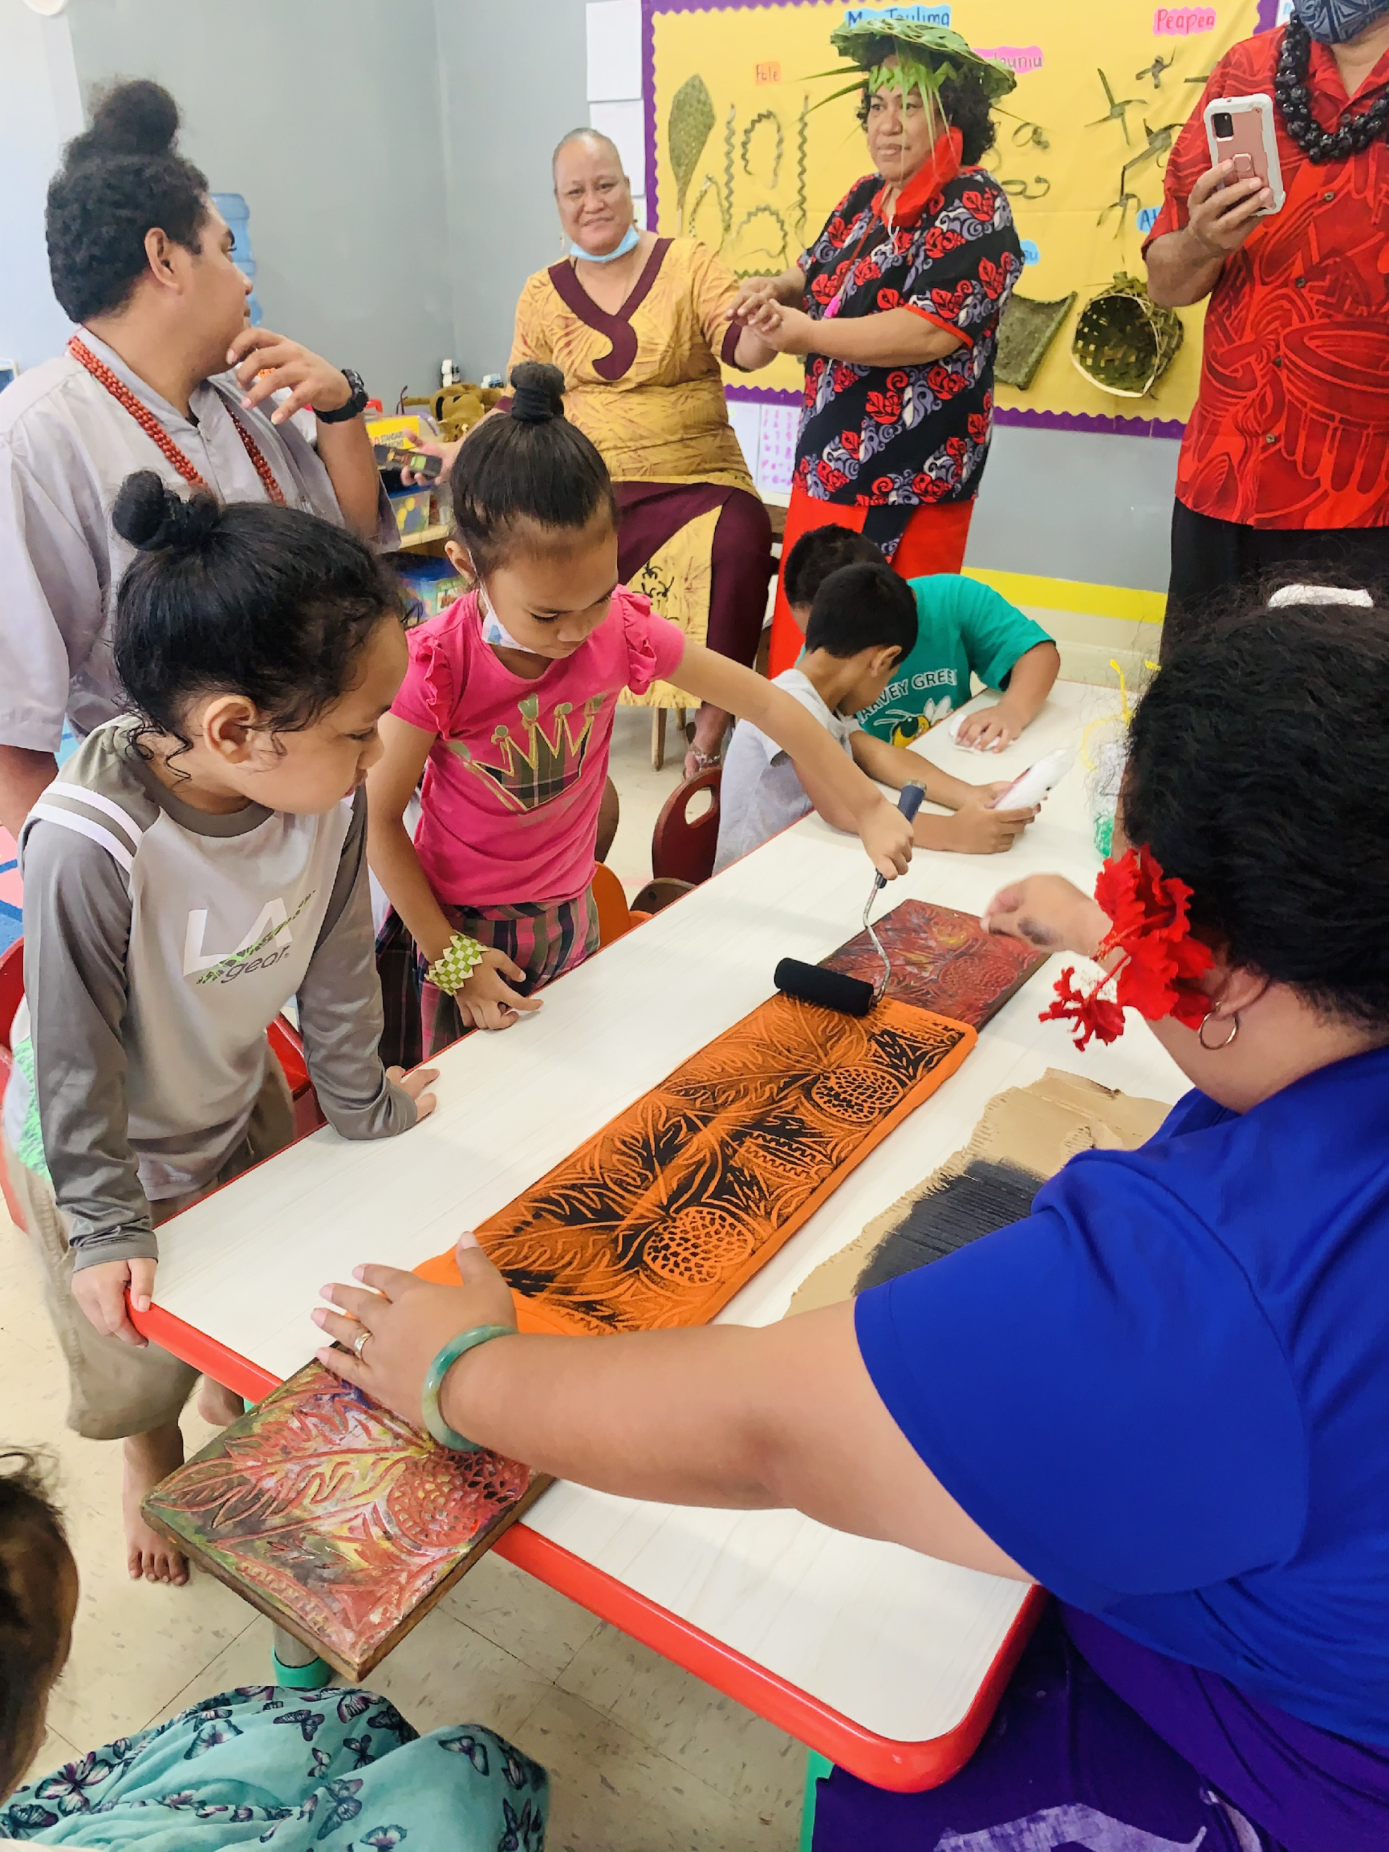
QUESTIONS?

